Slide 1
Why should I stay?
An analysis of what motivates people to CONTINUE working AT Frito lay

Slide 2
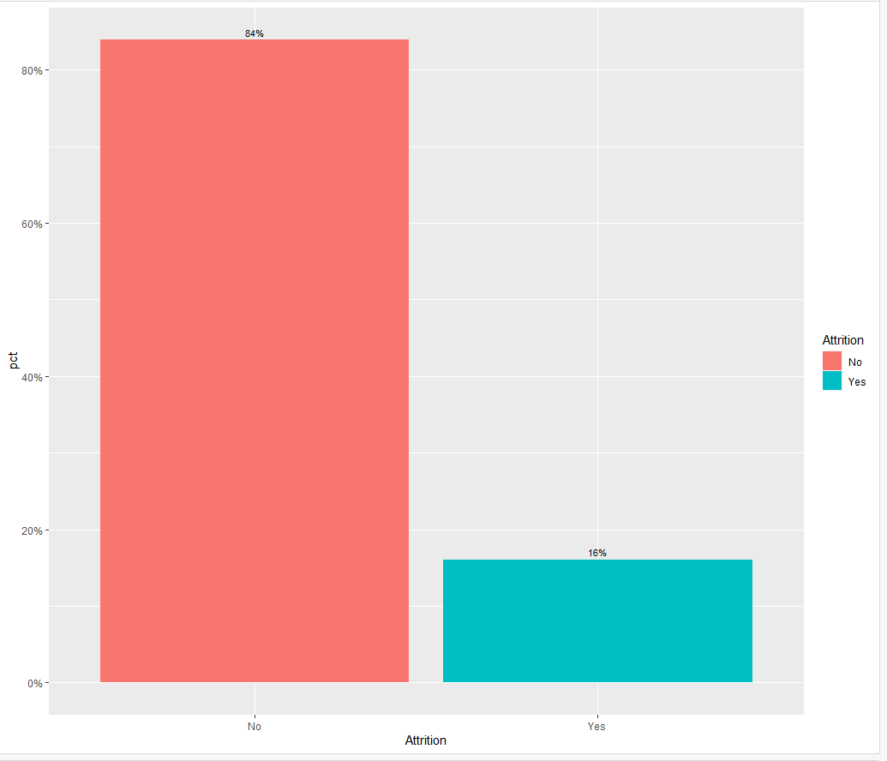
Defining the problem
84% of Frito Lay Employees stay with the company.
16% of Frito Lay Employees leave the company.

Slide 3
Assumptions and New Attributes
Frito Lay is interested in its employees and not the group responsible for hiring employees. HR was removed from the conversation.
The time frames for pay were limited to daily and monthly. We added yearly Salary and Salary Ranges
Although there are several jobs within Frito Lay, many of our findings depended on the categories of employment as a Manager vs. employment as a Non-Manager and so we created that attribute.
There was a numbering system for categories like Stock Option. We put words to those numbers to help show the meaning behind some of the correlations we found.

Slide 4
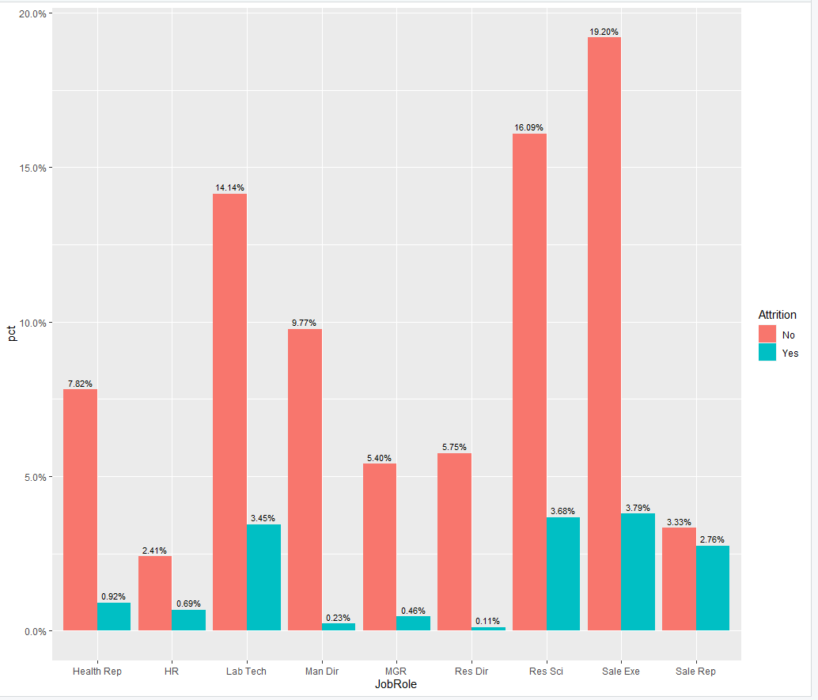
Job role specific trends
Trend
Research Director, Manager and Managing Director have the lowest attrition.
Lab Technician, Research Scientist, Sales Rep and Sales Exe. Have the highest attrition.

Slide 5
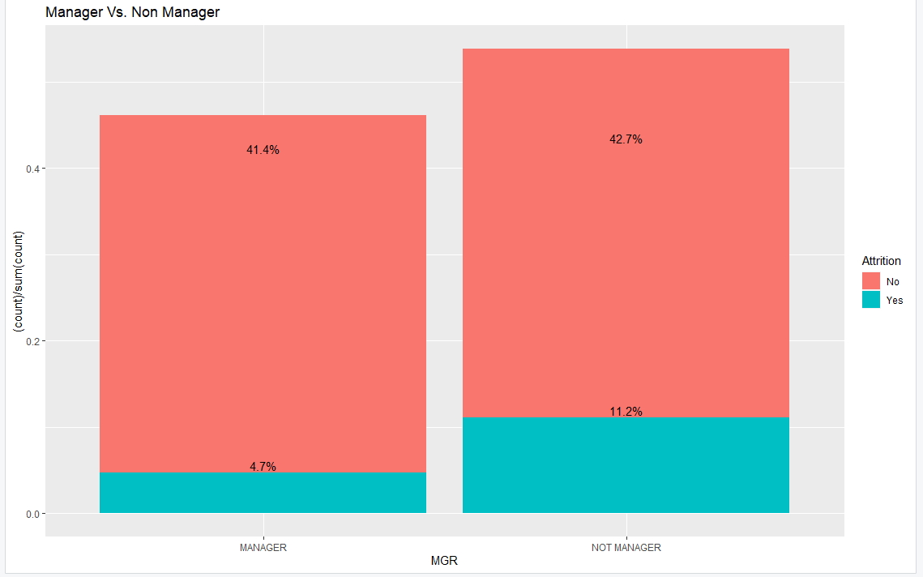

Slide 6
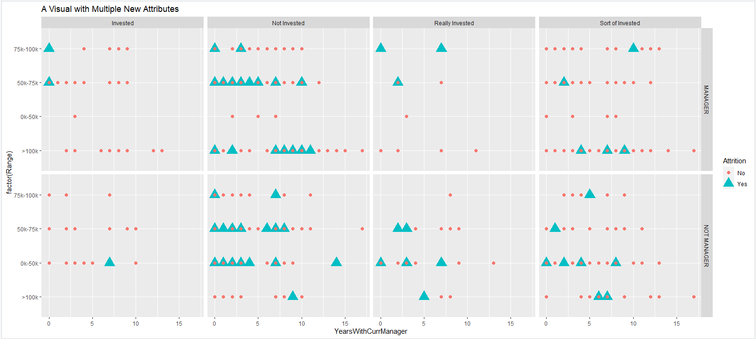

Slide 7
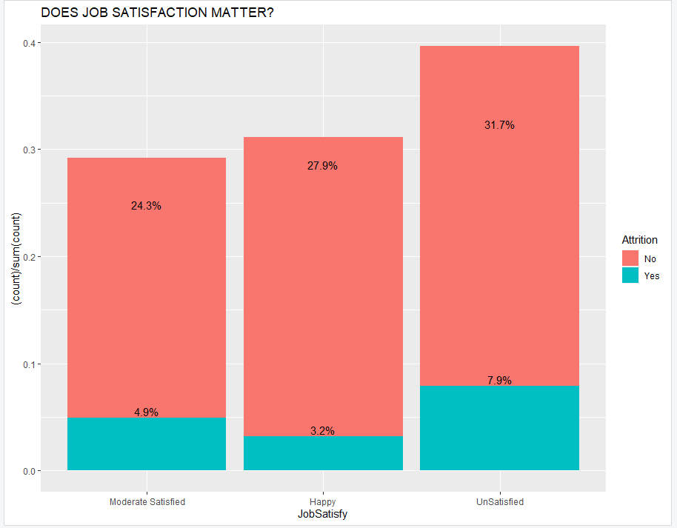
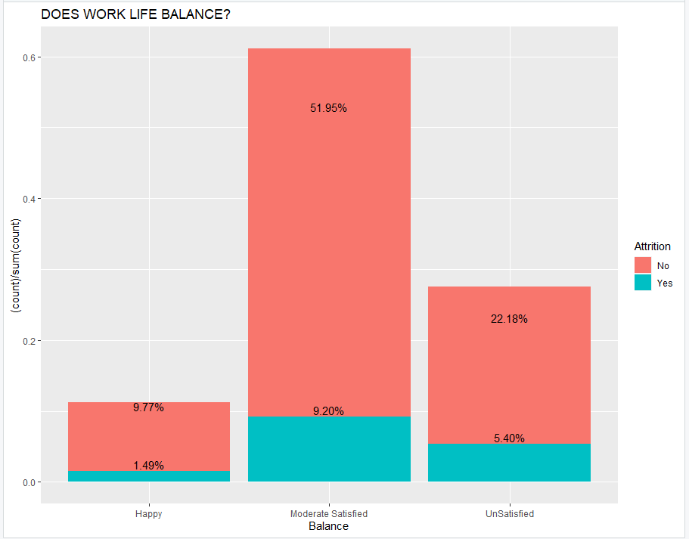
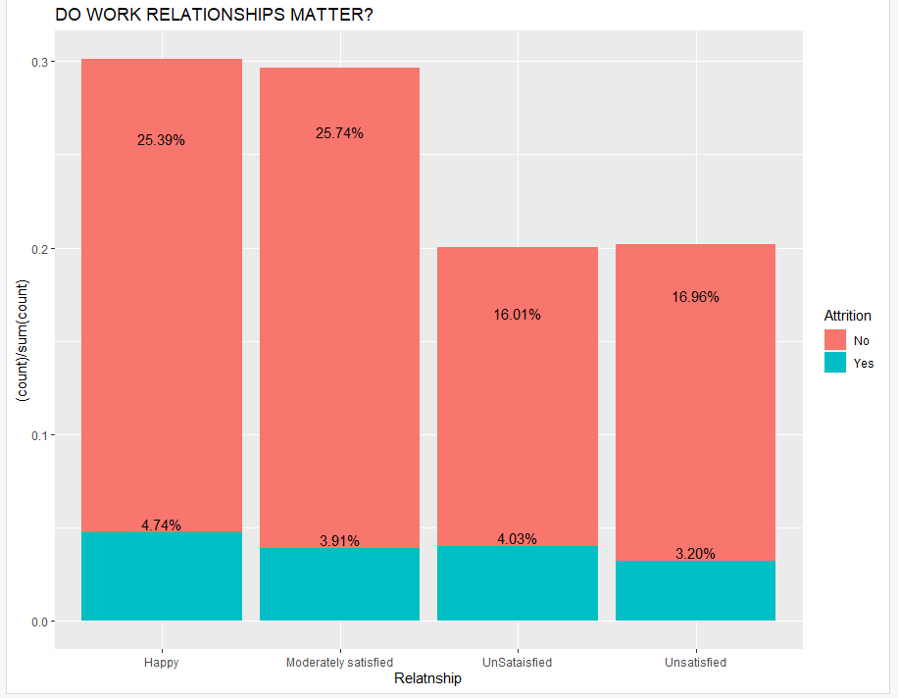
SOME COUNTERINTUITIVE FINDINGS

Slide 8
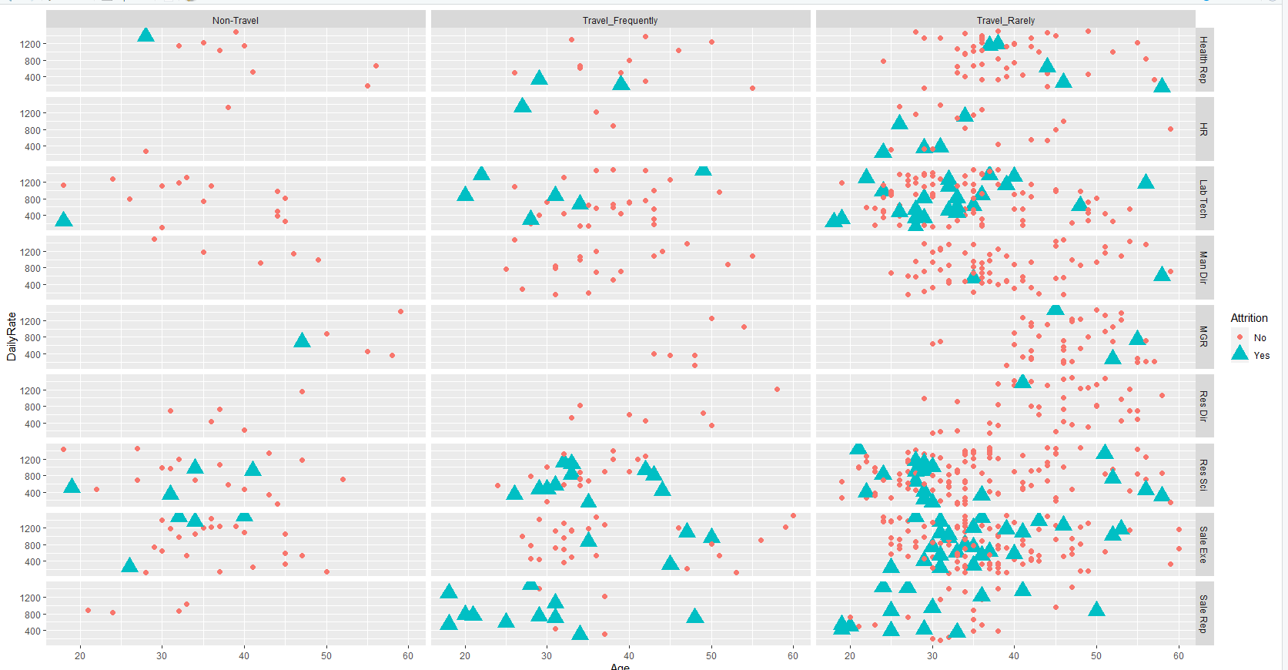
SOME COUNTERINTUITIVE FINDINGS
.I really thought jobs with heavy travel would be the leading cause of attrition but there is also an attrition problem with those who Travel Rarely.

Slide 9
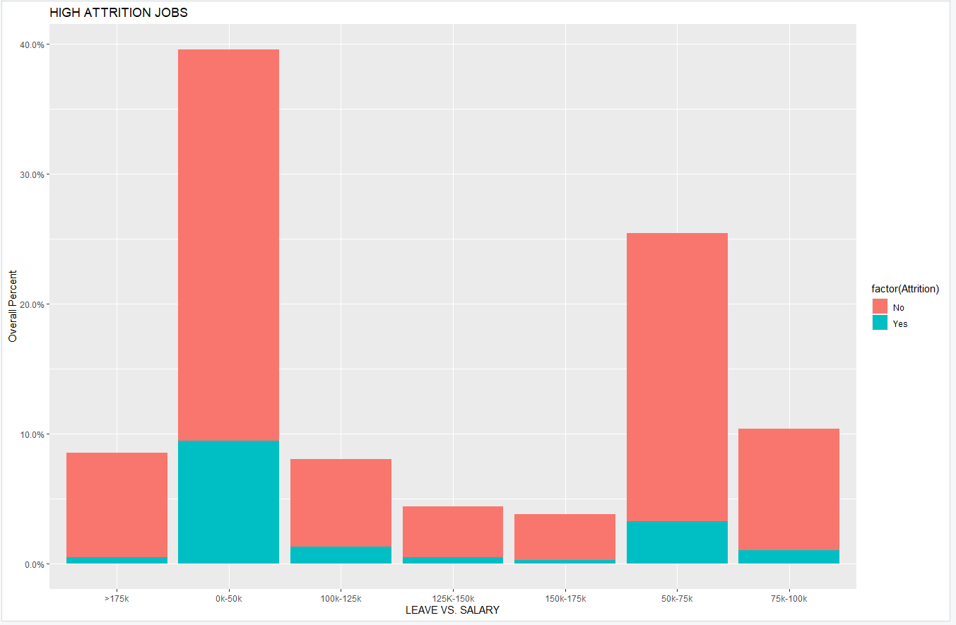
What does matter?

Slide 10
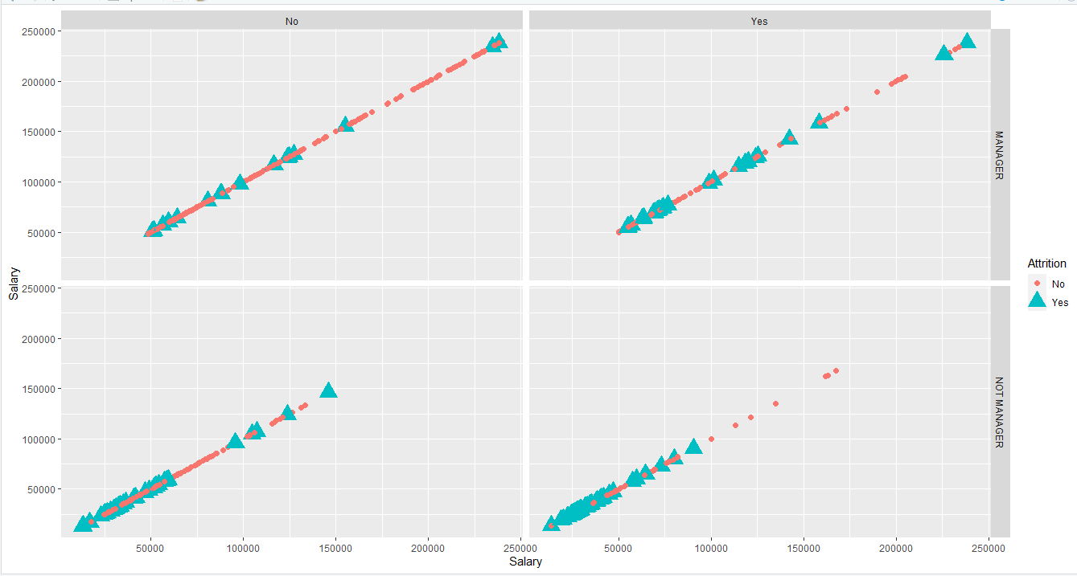
Overtime
Even if you offer Overtime as an opportunity to earn more money, the trend is higher attrition for Non- Managers.

Slide 11
TESTING MULTIPLE VARIABLES TO DETERMINE ATTRITION
We ran a Naïve Bayes on a test set, using multiple variables to see if we can predict whether a current employee will leave the company.

Slide 12
Top 3 factors that contribute to turnover
*We also added Marital Status to the model as Single/Married people disproportionately leave the company and Time with Current Manager. There is a disproportionately high attrition rate with those with a Manager under 2 years.
Manager vs. Non-Manager Non Managers are the most likely group of employees to leave the company.
*If you have been under your current manager for 2+ years, you are likely to stay
Stock Option Level
The higher the Stock Option Level, the more likely an employee is to stay at the company.
Yearly Salary
The top jobs for attrition make under $50k

Slide 13
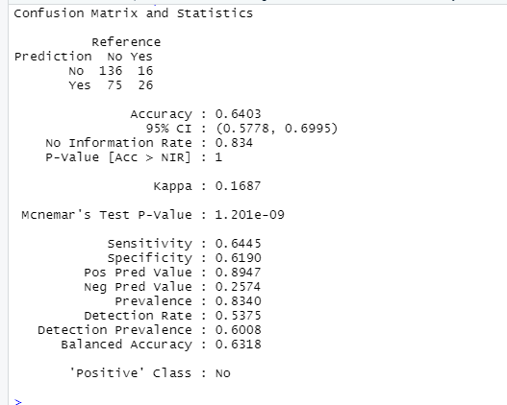
WHAT WE FOUND
*We used over Sampling to get Attrition levels on equal footing.
Sensitivity is when an employee did not leave the company and the percentage that our model predicted it, which is 64%
Specificity is when employee left the company and the percentage where our model predicted it, which is 62%
Accuracy is how often we were right with all our predictions, which is 64%

Slide 14
Initial Recommendation and question to pursue
During the onboarding of lower salary employees, spend significant time going over stock options and show them the amount of money those stocks can earn after 20+ years.
Is Frito Lay willing to look at Managers who have a high attrition rate with their employees and use your Top Managers to provide them with both leadership training and create a performance metric based on Attrition rates?
Is Frito lay willing to look at the reasons a Single/Married person is willing to leave a Manager/Company in an exit interview?

